Slide 1
Faculty of Industrial Sciences & Technology (FIST)

Slide 2
Chronological record of the establishment of FIST
2001
The government approved to establish a university at Pahang
2002
Establishment of University College of Engineering & Technology Malaysia (KUKTEM)
2006
2008
2007
KUKTEM is known as Universiti Malaysia Pahang (UMP); endorsed by the Cabinet
Approval of paperwork of establishment of FIST by senate
Refining paperwork of establishment of FIST and its academic programme
Approval of paperwork by Ministry of Higher Education Malaysia
FIST was officially established on 1 May 2008

Slide 3
Vision & Mission
Vision
We offer academic programs and consultancy as well as research in Science and Technology that emphasize industrial elements to produce holistic manpower to meet the stakeholders' need
Mission
To be a Science and Technology based faculty that meets industrial needs and serves as main reference center

Slide 4
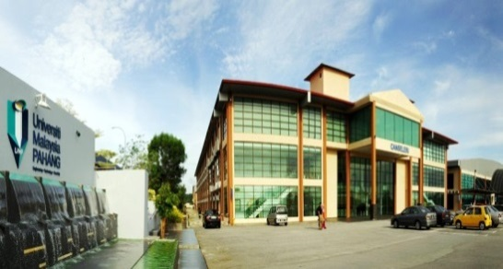
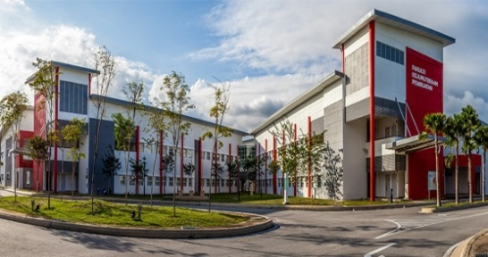
Campuses
Skills and practical based tertiary education
Specializes in engineering and technology

Slide 5
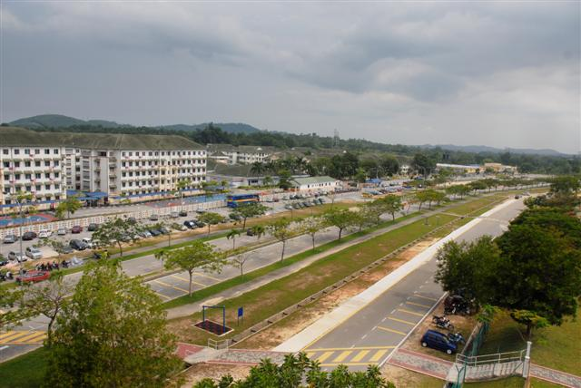
Faculties in UMP
Gambang Campus
Industrial Sciences & Technology
Chemical & Natural Resources Engineering
Civil Engineering & Earth Resources
Computer Systems & Software Engineering
Engineering Technology
Industrial Management
Pekan Campus
Mechanical Engineering,
Manufacturing Engineering
Electrical & Electronics Engineering

Slide 6
Staff of Material Technology Programme

Slide 7
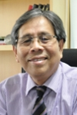
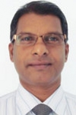
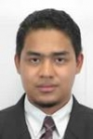
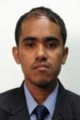
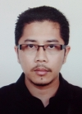
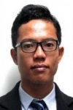
Staff and Expertise
Energy Materials Processing | Nanomaterials (Photovoltaic & Energy Storage) | Catalyst | Microwave materials
Photovoltaic & Realistic Modelling | Energy storage | Solid Electrolyte

Slide 8
Undergraduate Programmes
2008
BAppSc. (Honours)
Industrial Chemistry
2009
BAppSc. (Honours)
Industrial Biotechnology
2012
BAppSc. (Honours)
Material Technology

Slide 9
MATERIAL TECHNOLOGY CURRICULUM
Types of Courses | Credit Hours | Description
Core | (58+ *6 + **12 = 76) | Courses, *FYP, **Industrial Training
Elective | 15
Faculty | 16 | Applied Calculus, Applied Statistics, LQM, LSM, MVV, QAQCTL, Business Organization
University | 20 | Soft skills, language, co-curriculum, technical/report writing
Total Credit | 127 | Graduation Requirement = 127 credit hours
Type of courses | SEMESTER
 | 1 | 2 | 3 | 4 | 5 | 6 | 7 | 8
Core
Elective
Faculty
University
Final Yr. Project
Ind. Training

Slide 10
Courses Offered by Material Technology

Slide 11
Elective Courses
Thin Film Technology
Supercapacitor Technology
Solar Cell Technology
Corrosion
Liquid Crystals Technology
Molecular Modelling
Semiconductor Devices
Recycle Technology
Computational Physics

Slide 12
Postgraduates
Advanced Materials & Physics
Chemistry & Industrial Chemistry
Biotechnology
Nanostructured Materials
Natural Products
Bioprocess and Fermentation
Fine & Specialty Chemicals
Catalysis
Oleochemical
Petrochemical
Polymer Chemistry
Analytical Chemistry
Environmental Pollution Monitoring
Food Chemistry
Organometallic Chemistry
Other Chemistry Related Field
Enzyme/Protein Technology
Industrial Biochemistry
Industrial Microbiology
Bionanotechnology
Biosensor/Diagnostic Kits
Bioremediation
Cell Culture Technology
Food Microbiology
Drug Delivery and Discovery
Omics Technology
Plant Biotechnology
Carbohydrate Technology
Bioinformatics
Molecular Biology
Other Biotechnology Related Field
Mathematical Modelling/ Fluid Flows/ Heat Mass Transfer
Mathematics and Statistics
Renewable Energy Materials and Devices
Supercapacitors
Semiconductor Physics
Optical Physics
Polymer Nanocomposites
Biomaterials
Other Advanced Materials and Physics Related Field
Fluid Dynamic
Solid Mechanics
Numerical Analysis
Mathematical Education
Group Analysis
Bio-mathematics
Computer Aided Geometric Design (CAGD)
Rainfall Modelling
Pattern Recognition
Structural Equation Modelling
Stochastic Modelling
Time Series Analysis
Multivariate Analysis
Operational Research
Interdisciplinary Research
Quality & Productivity
Circular Statistics
Environmental Statistics
Other Mathematical Related Field

Slide 13
Research Clusters
DRUG DISCOVERY & DIAGNOSTICS Dr. Jaya Vejayan | ADVANCED MATERIALS Prof. Dr. Jose Rajan | GREEN TECHNOLOGY Dr. Essam Makky | APPLIED & IND. MATHEMATICS Dr. Mohd Sham
Omics Technology Biodiagnostics Organic Synthesis Natural Products | Functional Materials Photonic Materials Catalyst | Biomass Conversion Bioremediation Plants, Soils & Microbe Renewable Energy | Market & Trends Dynamical System

Slide 14
Grants (cluster-based)
81 active grants
RM 6 Million

Slide 15
FIST-INDUSTRY STRATEGIC PARTNERSHIP
CURRICULUM
Fundamental
Industry-based
Practical
INDUSTRIAL EXPOSURE
Visit to industry
Co-lecturing
Industry talk series
ACADEMIC
INDUSTRY PARTNERSHIP
Curriculum review (IAP/BOS)
Attachment/exchange expertise
Resource sharing
STRUCTURED INDUSTRIAL TRAINING
Relevant FYP
Industrial training
Extended training

Slide 16
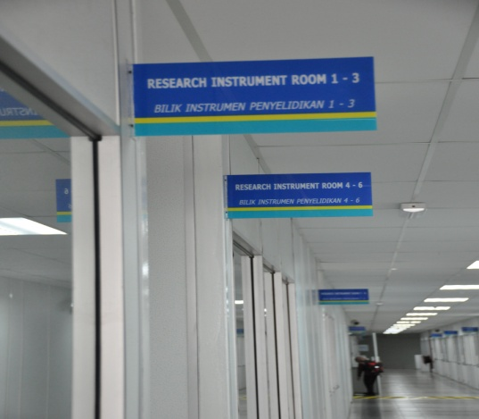
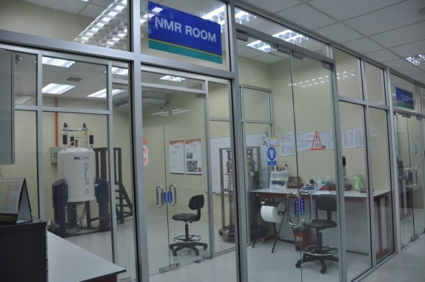
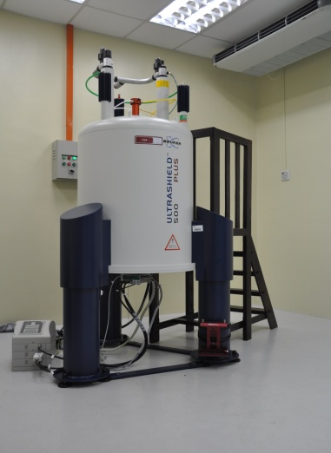
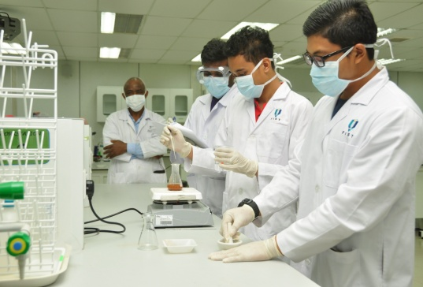
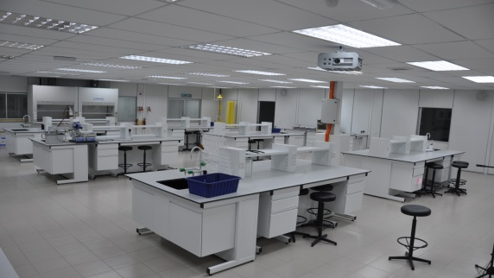
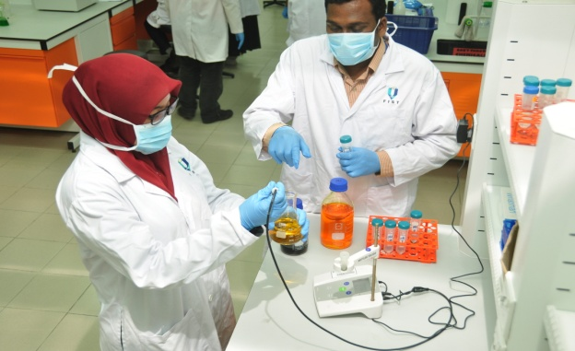
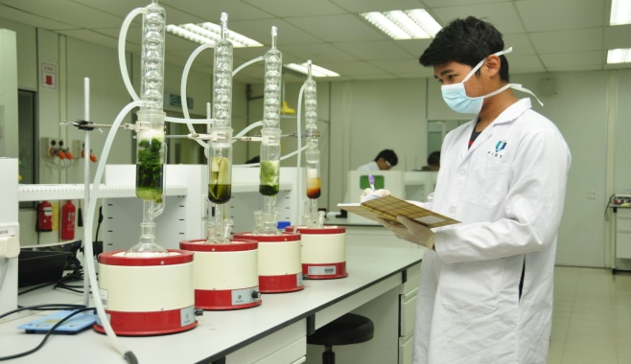
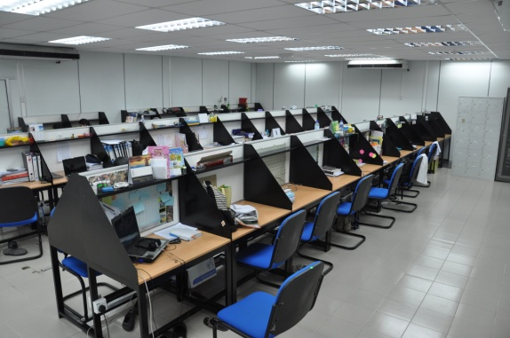
NMR
LABORATORIES
& RESEARCH FACILITIES

Slide 17
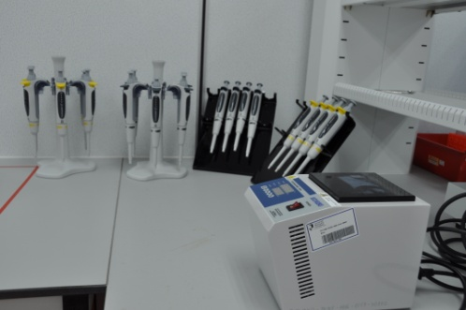
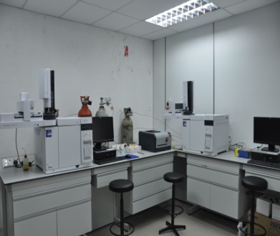
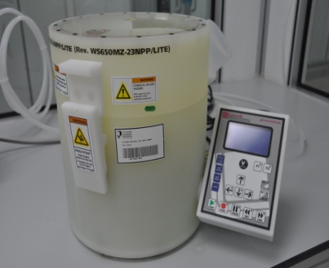
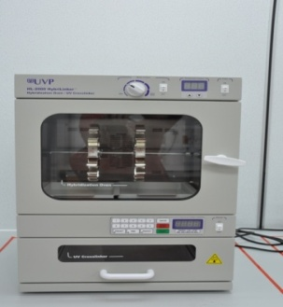
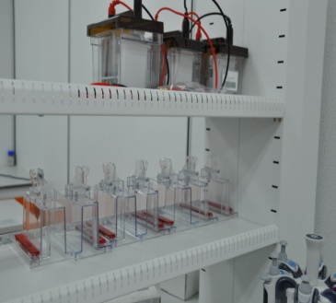
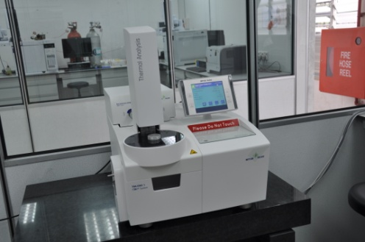
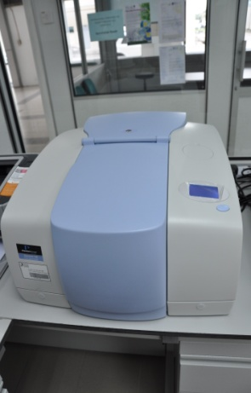
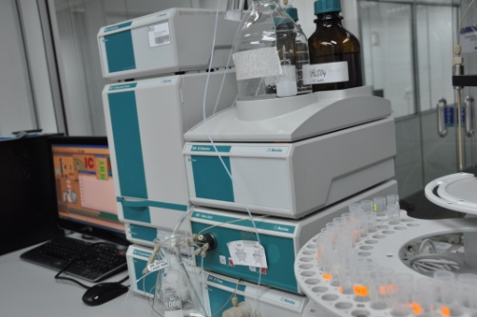
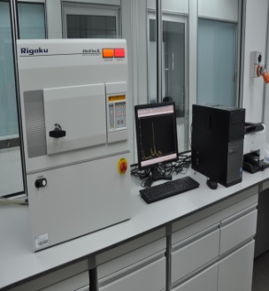
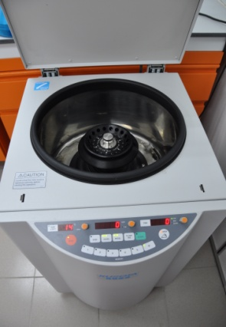
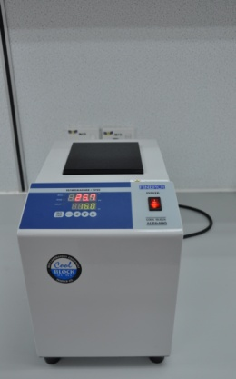
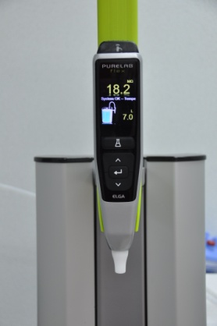
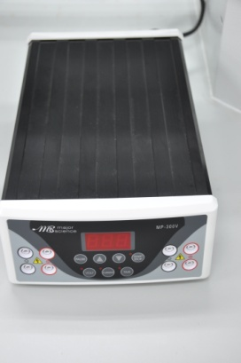
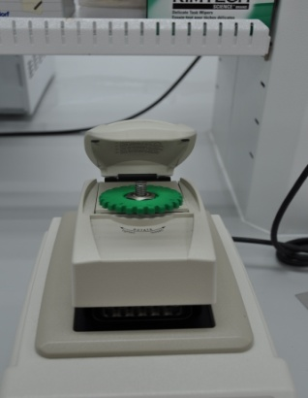
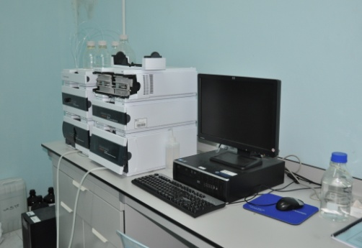
LABORATORIES
& RESEARCH FACILITIES

Slide 18
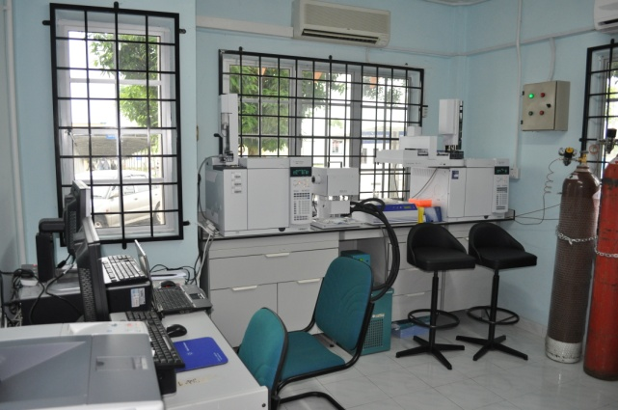
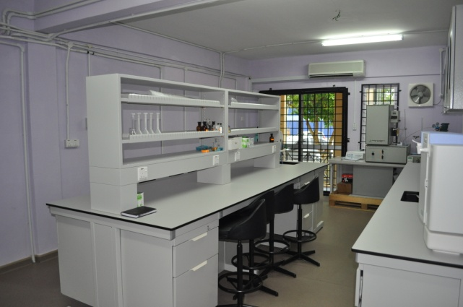
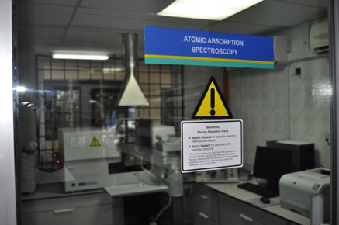
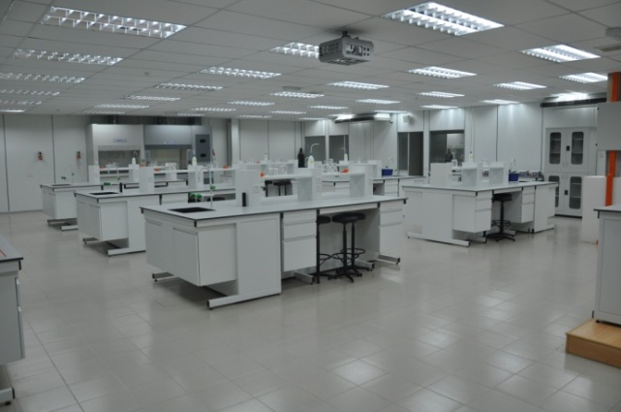
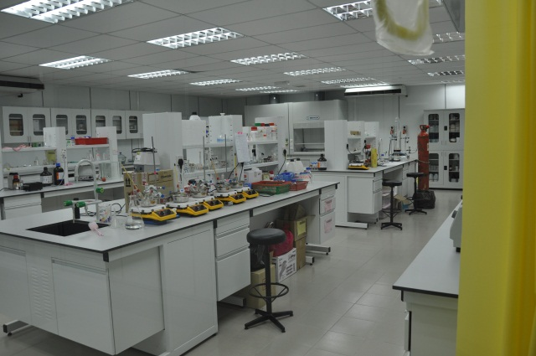
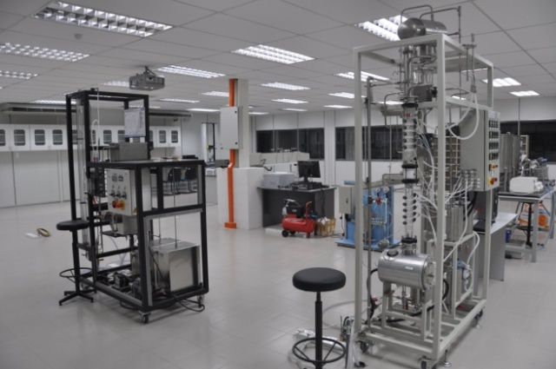
Teaching and research laboratories
Analytical chemistry laboratory
Organic chemistry laboratory
Unit operation laboratory

Slide 19
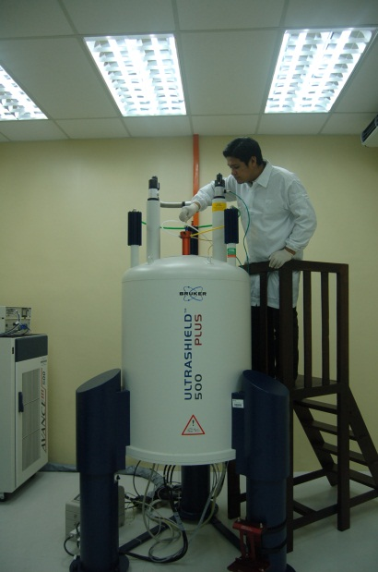
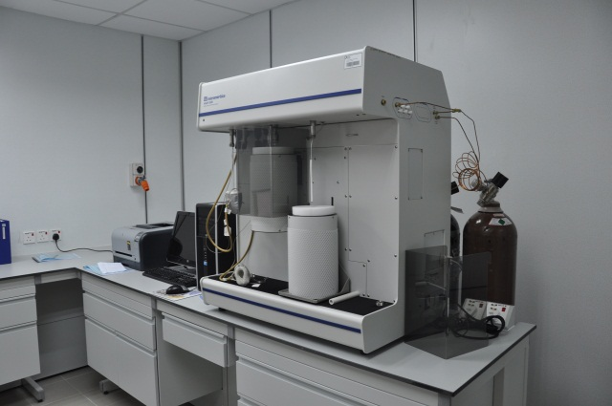
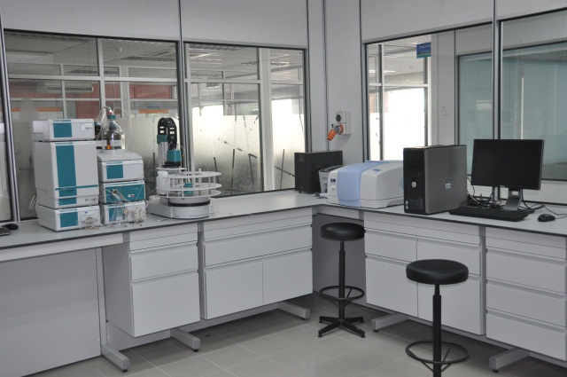
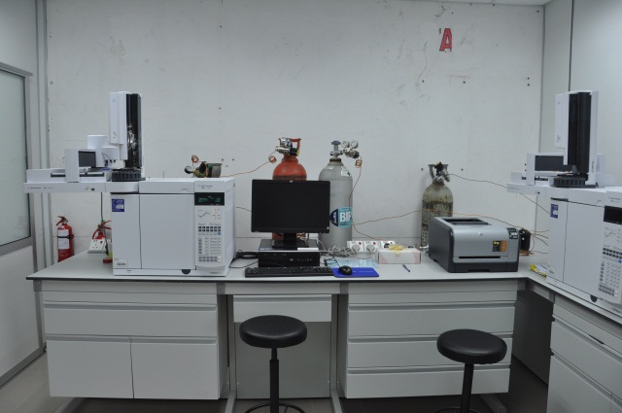
Physisorption analyser
Nuclear magnetic resonance spectrometer
Thermal gravimetric analyser
Ion chromatography,
UV-Visible spectrometer
X-ray diffractometer
Gas chromatography

Slide 20
Consultancy & Technical Services / Facility Sharing / Joint Research Lab
Research & Development & Commercialization
Outward and Inward Exchanges
Industry Talks
Industry PhD
Community Service
University–Industry Interactions
Part-time expert lecturer
Company Profiling (in Website)
Technology Transfer/Patenting
Industry Panel/Expert (IAP)
Undergraduate Structured Internships

Slide 21
THANK YOU

