Slide 1
Ab-initio Density Functional Theory: from quantum dots to solar cell
Saifful Kamaluddin Muzakir
Staf ID: 01009
019 276 3844
skmuzakir@yahoo.com
www.facebook.com/Saifful Kamaluddin

Slide 2
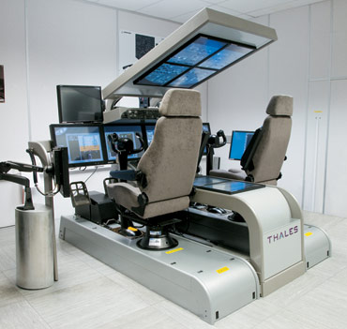


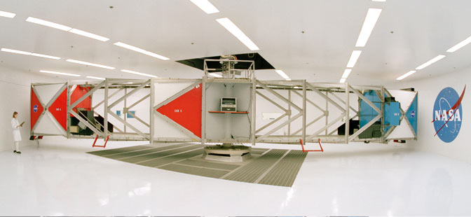


Simulation vs animation
Result
Unknown
Known
Scientific
based
Fundamental
Fiction/imaginary
Fundamental
parameter
Input
Script/
storyboard
Complicated
Calculation
Simple or
none
Eq.’s accuracy
dependency
Realistic
Script’s
dependency
Predict
results
Usage
Tell
results
Investigative Technologies Inc.

Slide 3




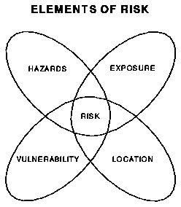
The advantages of simulation
wet lab
Excited state
Cluster size
Ground state
Electron density
Absorption spectroscopy
IR spectroscopy

Slide 4
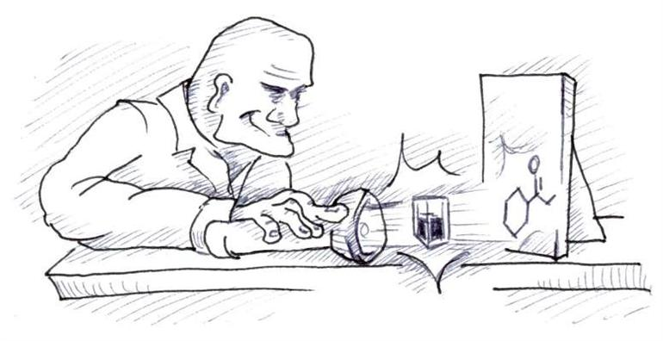



Ab initio
Crystallographic profile, number of electrons, neutrons, protons
Dr. Izan
Experimental data
Maths
functions & functionals
Material
properties
1
2
…..
1,000,000
OUTPUT

Slide 5
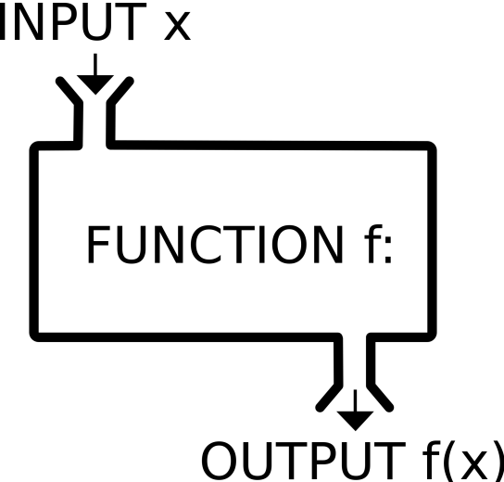
Function
y = f(x) = 2x+3
OUTPUT y
“y is a function of x”
Vito Volterra “Theory of functionals and of Integral and Integro-Differential Equations” (1930)

Slide 6
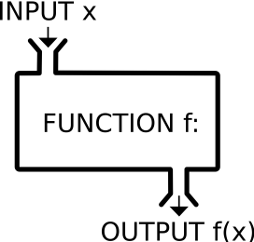
Functional
g(x)=2x
h(x)=4x
i(x)=x+2
z =
g(x)+h(x)-i(x)
OUTPUT z
“z is a functional of x”

Slide 7
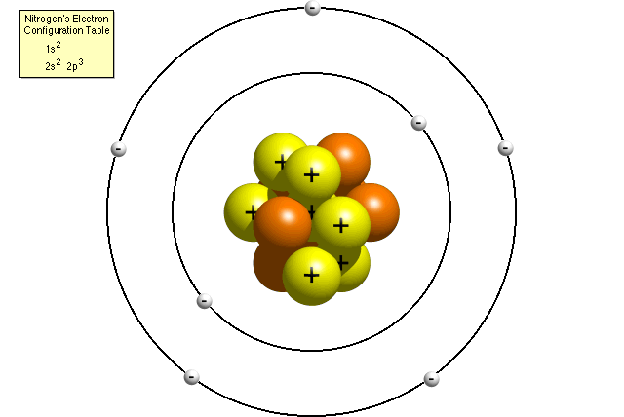
Density Functional Theory
electron density, ρ
ρ
ρ
ρ
ρ
ρ
K.E_{e}
K.E_{n}
P.E_{e-n}
P.E_{e-e}
P.E_{n-n}
E_{xc}
ΣE= Σ(K.E)+ Σ(P.E)
OUTPUT
Total Ground State Energy
“Total ground state energy of a system is a functional of electron density”

Slide 8
From Schrödinger’s equation to DFT
Hψ= Eψ
H
Ψ: Probability amplitude of particle in a state
E:
Calculated Eigenvalue / energy
Predicts the evolution behaviour of a dynamic system
Mathematical function that describe a system in the form of summation of K.E & P.E
Determine by Basis set
Determine by Functional

Slide 9

DFT evolution
Early DFT (1970s):
Hψ= Eψ
(ΣE)ψ=(ΣK.E + ΣP.E)ψ
=(K.E_{nuc} + K.E_{elec.} + P.E_{n-n} + P.E_{e-n} + P.E_{e-e})ψ
Modern DFT (1990s):
(ΣE)ψ=[K.E_{elec.} + P.E_{e-n} + P.E_{e-e} + E_{xc}]ψ
(ΣE)ψ=[K.E_{e}(ρ)+ P.E_{e-n}(ρ) + P.E_{e-e}(ρ) + E_{xc}(ρ)]ψ
Nucleus is heavy and ~static: K.E= ~0
Nucleus is neutralized:
$$P.E=\frac{kq1q2}{r}=0$$

Slide 10
Basis set & Functional (model)
Basis set:
Set of wavefunction, ψ
Shape of each atom’s orbitals (AOs)
Calculations with approximations & corrections
Functional:
System modeling, H
Molecular Orbitals (MOs)
Energy
(Warren J. Hehre. Wavefunction Inc. 1996)
(Errol G. Lewars, 2011)

Slide 11
Choice of functional
System Size
Very big
>250,000 atoms
(<250,000 atoms)
Big-Small
Small
<12 atoms
Molecular mechanics
Qualitative result/ Short on time?
Yes
No
DISCLAIMER: The accuracy of results also heavily depends on the basis set used!
Accuracy Increases
ions, excited state…
Same orbital spatial functions for all electrons
UHF
Accuracy Increases
Ab initio: HF
Semi empirical (G09 W)
RHF
Different functions
paired e⁻ species
PM3
ZINDO
Etc..
DFT: B3LYP
MORE FUNCTIONAL DETAILS:
http://www.gaussian.com/g_tech/g_ur/k_dft.htm
There other models not listed. Here are the most common

Slide 12
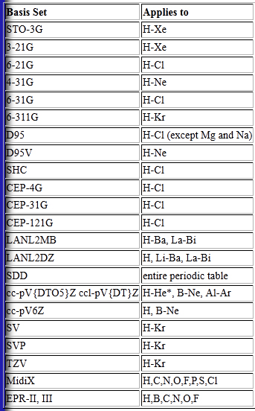
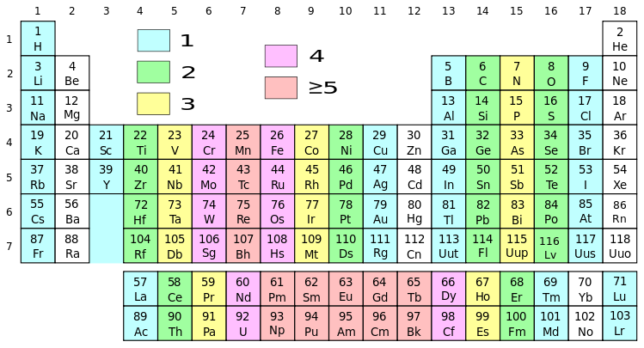
Limitation of basis set
CdSe
http://www.gaussian.com/g_tech/g_ur/m_basis_sets.htm

Slide 13
Basis set choices
Narrow down choices:
by limitation
Literature review:
Any previous theoretical work?
NO
Produce own experimental results
YES
NO
Use the same basis set
Use all short-listed basis sets
Realistic molecular/cluster model
YES
Simulate results
Comparison with previous experimental work. Any published work?

Slide 14
Basis set accuracy: comparison with experimental data
Literature
Dye 1
Ligand-QD
Dye 2
CdSe QD
List of basis set: http://www.gaussian.com/g_tech/g_ur/m_basis_sets.htm

Slide 15
Application: Quantum dot solar cell
Working electrode
Counter electrode
TiO₂
Quantum dot
Ligand
Ligand
Ligand
e⁻
Ligand
e⁻
TiO₂
Ligand
Ligand
Ligand
Electrolyte
e⁻
e⁻
e⁻
e⁻
A. Electron injections:
Is it POSSIBLE & EFFICIENT?
Ligand
QD
B. Ligand-QD adsorption
Is it POSSIBLE & HOW STRONG?

Slide 16
Series of simulation
PROCESSES
RESULTS
INPUT
Structure optimization
Optimization of: Bond length, Angle and Dihedral angle
With estimated parameters (to be optimized)
Frequency simulation
Positive vibrational frequency: A realistic molecular/cluster model
Energy calculation
Energy: Ground state & excited state
Full population simulation
Visualization of excited and ground state’s electron density
Size calculation
Size of modeled molecule/cluster

Slide 17
Input preparations
Input:
  Molecules (i.e., ligand molecules)
  Quasi-Crystals (Quantum dots semiconductor)
Drawing Tools:
  ChemDraw
  Chem3D
  Gaussview
  Ab initio DFT Tool: Gaussian 09W

Slide 18
Input: Ligand molecule
What is a molecule?
A group of atoms bonded together, representing the smallest fundamental unit of a chemical compound that can take part in a chemical reaction
A single molecule can represents a system consists of ten/hundreds/thousands/millions/billions of them
Merriam-Webster Dictionary

Slide 19
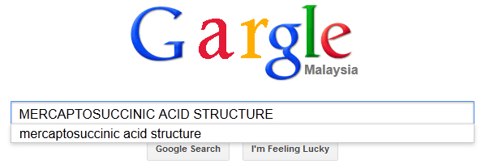


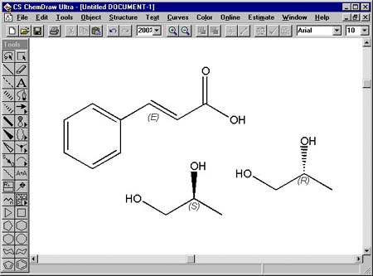
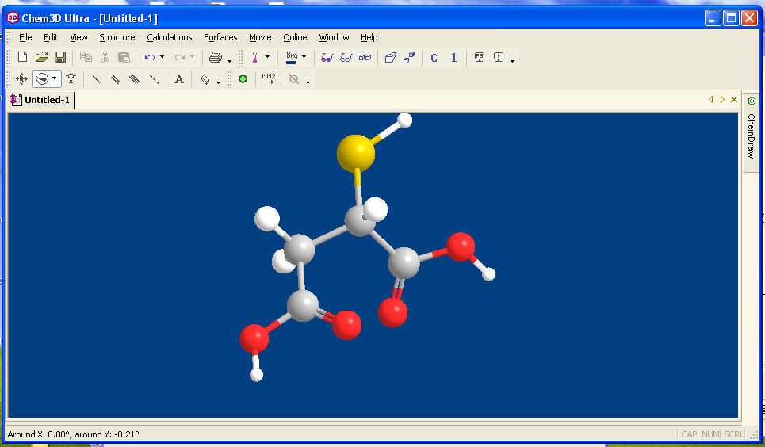
Input Step 1: Draw molecule
Molecule
HS
O
O
HO
OH
Draw using Chemdraw
HS
Save As *.mol2
O
O
HO
OH
Chemdraw 3D & release
Select All, Grab & Drag to

Slide 20
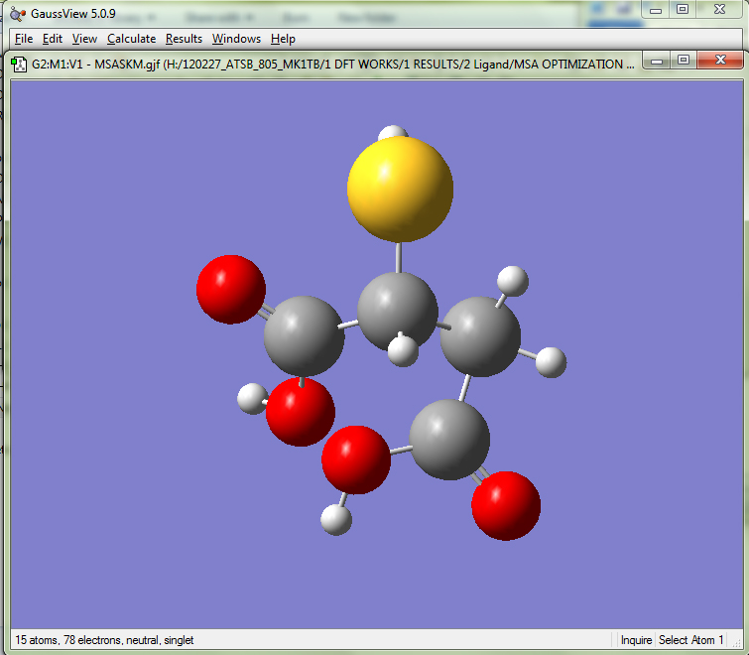
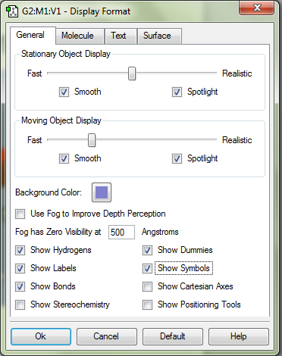
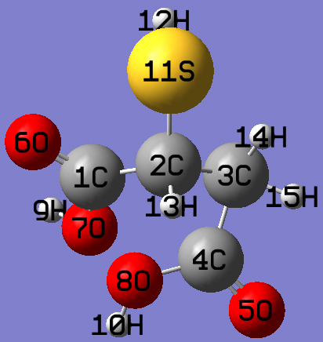
Input Step 2: Labeling molecule
Molecule
Open *.mol2 file using
Gaussview 5.0
1. Right click
2. Select “View”

Slide 21
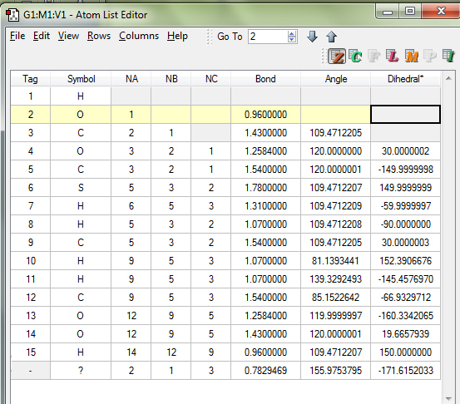
Input Step 3: Rearrange numbers
Molecule
Click “edit” – “Atom list”
A new interface appears: showing labels. Rearrange the numbers in a nice flow.
Computer generated Z-Matrix:
Pro: Can be straight away use as simulation input.
Con: Tested & may cause longer simulation time.
Solution: Spend time building our own Z-Matrix
Before & After

Slide 22
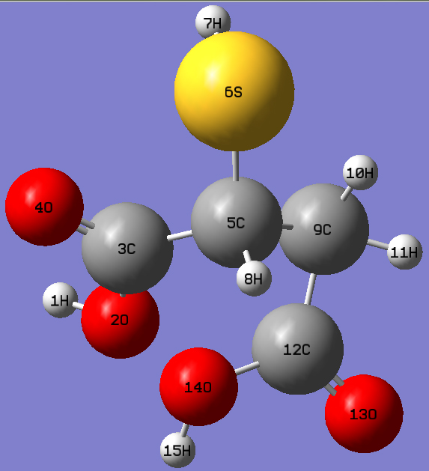
Input Step 4: Building z-matrix
Molecule
Define all atoms using:
  Bond length
  Angle
  Dihedral angle
1H need no definition: starts from here
2O is connected to 1H by A BOND
3C is connected to 2O by A BOND
is bent from 1H by AN ANGLE
4O is connected to 3C by A BOND
is bent from 2O by AN ANGLE
is twisted from 1H by a DIHEDRAL ANGLE
5C is…next slide

Slide 23
Input Step 5: Defining bond, angle
& dihedral angle
Molecule
5C is connected to by a bond
is bent from by an angle
is twisted from by a dihedral angle
5C
3C
1H
2O
5C
5C
3C
2O
3C
2O
1H
1H
?
3C
?
2O
?
1H

Slide 24
Input Step 6: Z-matrix, the format
Molecule
1H
2O is connected to 1H by A BOND
3C is connected to 2O by A BOND
is bent from 1H by AN ANGLE
4O is connected to 3C by A BOND
is bent from 2O by AN ANGLE
is twisted from 1H by a DIHEDRAL ANGLE
H
O 1 B1
C 2 B2 1 A1
O 3 B3 2 A2 1 D1
A description of an atom must be:
In 1 LINE
Each line is meant for 1 atom’s description ONLY
May use any symbol for bond, angle and dihedral
B1, B2, A1…D1….must be stated as simulation parameters and the value will be optimized OR as CONSTANT
i. stated in DECIMAL POINT as INDICATION of CONSTANT, i.e., 1.546
ii. stated in the form of 1. ONLY as INDICATION of TO BE OPTIMIZED
(Will show the full format later)

Slide 25

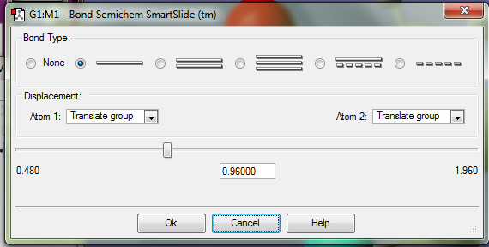
Input Step 7: Estimating bond length
Molecule
H
O 1 B1
C 2 B2 1 A1
C 3 B3 2 A2 1 D1
If we want to:
(a) Make it as constant, change B1 with “0.96” in the Z-Matrix
(b) Optimize the value, write “B1=1.”

Slide 26
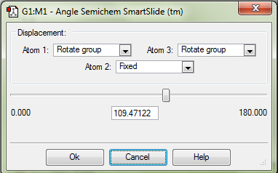
Input Step 8: Estimating angle
Molecule
H
O 1 B1
C 2 B2 1 A1
C 3 B3 2 A2 1 D1
B2=1.43
A1=109.47122

Slide 27
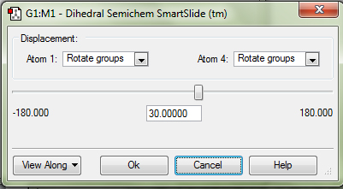
Input Step 9: Estimating dihedral angle
Molecule
H
O 1 B1
C 2 B2 1 A1
C 3 B3 2 A2 1 D1
B3=1.2584
A2=120.0
D1=30.0

Slide 28
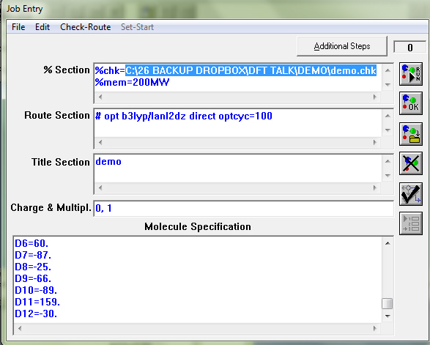
Input Step 10: Full Z-Matrix
Molecule
FULL Z-MATRIX
TEST the z-matrix:
  Open Gaussian 09W
  Click “File” & “New”
  Key in %section,route section
  and title as indicated
  Copy & Paste the Z-matrix
  in the “Molecule
  Specification” field
  Save Job As….(any name)
  Open the file using Gaussview 5.0
  If the Z-Matrix is CORRECT, it will show the same molecule model as the reference

Slide 29
Input: Done
Molecule
Build reference molecule
Gaussview
Chemdraw
Building z-matrix
From 2D to 3D
Word processing
Build Z-matrix
Gaussview
Write down z-matrix
Rearrange labels
Z-matrix testing
REFINE THE MODEL:
Check Z-matrix and
Gaussian setting
Key in setting, z-matrix & save the MODEL
Gaussian
Is the model similar to the reference molecule?
YES
ERROR/NO
RUN the simulation on Gaussian
WHICH PROCESS?

Slide 30
Series of simulation
Molecule
PROCESSES
RESULTS
INPUT
Structure optimization
Optimization of: Bond length, Angle and Dihedral angle
With estimated parameters (to be optimized)
Frequency simulation
Positive vibrational frequency: A realistic molecular/cluster model
Energy calculation
Energy: Ground state & excited state
Full population simulation
Visualization of excited and ground state’s electron density
Size calculation
Size of modeled molecule/cluster

Slide 31
%Section field
Molecule

Slide 32
%Section field
Molecule
The directory to save “.chk” file (a file that records all calculations, achievable at any simulation process by using “check” command in “Route Section”):
%chk= C:\g09w\PbTe.chk
Stating the amount of memory usage in MW (megawords). 1 MW=3.81 MBytes
%mem=200MW

Slide 33
Route Section field
Molecule

Slide 34
Route Section 1: Geometry opt.
Molecule
Stating the command line of simulation:
# opt b3lyp/lanl2dz direct optcyc=100
Functional
Basis set
No calculation storage required (faster process)
Max number of optimization
Geometry optimization command
Job initiation

Slide 35
Route Section 2: Frequency
Molecule
Stating the command line of simulation:
#n b3lyp/lanl2dz direct freq geom=check guess=check
Default:
Normal print level of output
Frequency command
Retrieve molecular orbitals data from “.chk” file (previous geometry opt.)
Retrieve internal coordinate from “.chk” file (previous geometry opt.)
Without “geom=check” and “guess=check” command:
Have to state “Optimized Z-matrix” in the “Molecule Spec” field

Slide 36
Route Section 3: Energy
Molecule
Stating the command line of simulation:
#n b3lyp/lanl2dz direct TD (direct, singlet, root=1, Nstates=50)geom=check guess=check
Time dependent
Singlet excited state
Number of each type of state to be solved. Default=3
State of interest. Default is 1 (first excited state)

Slide 37
Route Section 4: Full population
Molecule
Stating the command line of simulation:
#n b3lyp/lanl2dz pop=full geom=check guess=check
Molecular orbitals visualization, total atomic charge and orbital energies

Slide 38
Route Section 5:
Cluster size estimation
Molecule
Stating the command line of simulation:
#p b3lyp/lanl2dz scrf=pcm geom=check
Choices of solvent (to be specified in command line): http://www.gaussian.com/g_tech/g_ur/k_scrf.htm
Calculate volume & surface area of cluster in solution. Default: Water
Additional output (execution timing, messages etc)
Use with energy, geometry opt, freq calc to model systems in solution

Slide 39
Charge & Multiplicity
Molecule

Slide 40
Charge & multiplicity
Molecule
Charge: total charge of the molecule OR cluster = 0
 | NUMBER | CHARGE | TOTAL
C | 4 | 4 | 16
O | 4 | -2 | -8
H | 6 | -1 | -6
S | 1 | -2 | -2
TOTAL CHARGE |  |  | 0

Slide 41
Charge & multiplicity
Molecule
Multiplicity/spin multiplicity: describes how the electrons of the system exist
2S+1=spin multiplicity, where S is total spin quantum number
S=n(1/2) where n=unpaired electron
H
H
H
S
H
O
O
Inorganic Chemistry
J.E. House, Academic Press 2008
mercaptosuccinic acid molecule
O
O
H
H

Slide 42
The rough model: mercaptosuccinic acid
Molecule
Element | Config. | Valence e-
H | 1 | 1
C | 2.4 | 4
O | 2.6 | 6
S | 2.8.6 | 6
H
H
H
H
C
C
S
O
O
C
C
H
S
H
H
O
O
H
C
C
H
H
C
C
O
O
UNPAIRED ELECTRON, n=0
Spin multiplicity, 2S+1=2(n(1/2))+1=2(0)+1=1
H
H
O
O

Slide 43
Running the simulation
Molecule
Specify *.chk directory & memory
Click RUN
Pop up message: specifying output directory
Command line
Your desired title
Molecule/cluster charge & spin multiplicity
Molecule/cluster’s Z-Matrix

Slide 44
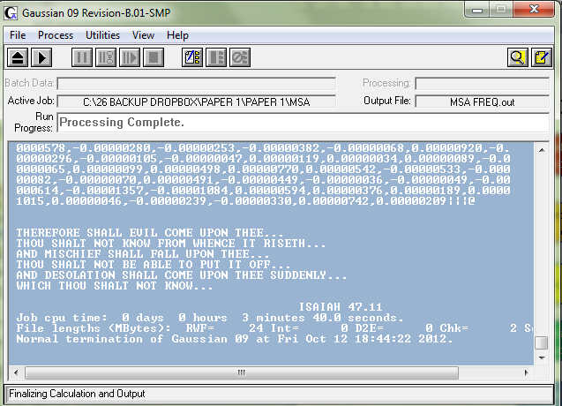
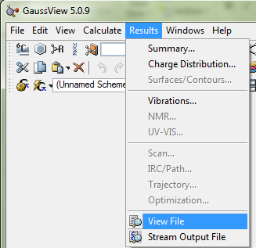
Extracting result:
Structure optimization
Molecule
Optimization complete
Double click the output
Frequency simulation
Open in Gaussview
Energy calculation
Work doesn’t kill,
But worry does
-unknown post graduate student
Save as Gaussian Input Files (.gjf)
Full population simulation
Input for NEXT SIMULATION
Size calculation

Slide 45
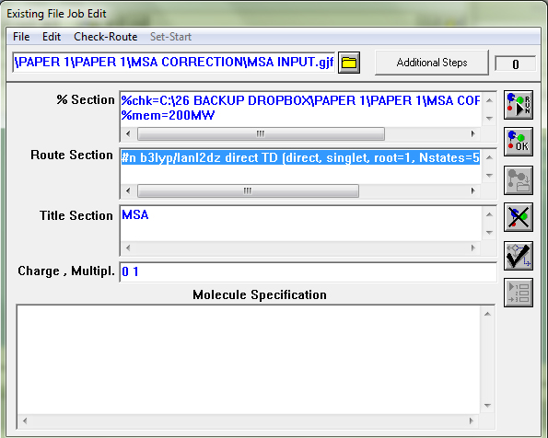
Input for Frequency, Energy, Full Population & Size
Molecule
Open Gaussian
Click File
Click Open
Select the saved “Structure optimization output” which saved as .gjf
A new interface appears (as shown)
Change “Route Section” to frequency/energy/full population/size command
Leave “Molecule Specification” blank
Click RUN
Specify output directory

Slide 46
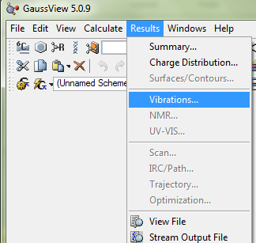
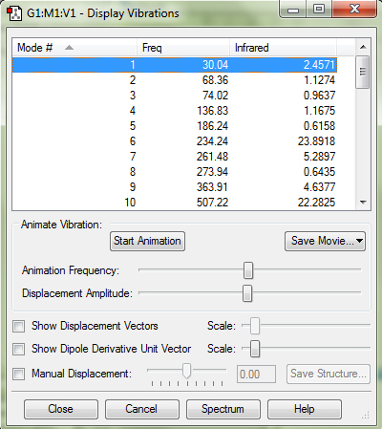
Analyzing result:
Frequency simulation
Molecule
Completed Freq. simulation
Double click the output
Open in Gaussview
REALISTIC MOLECULAR MODEL:
Positive frequencies

Slide 47
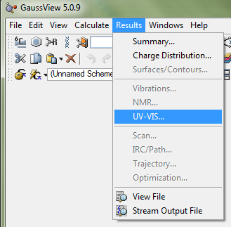
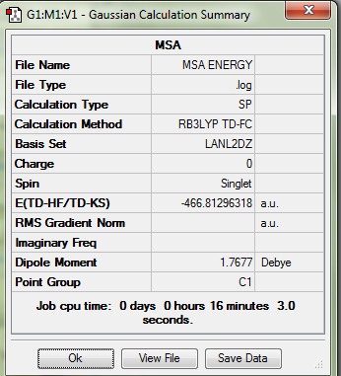
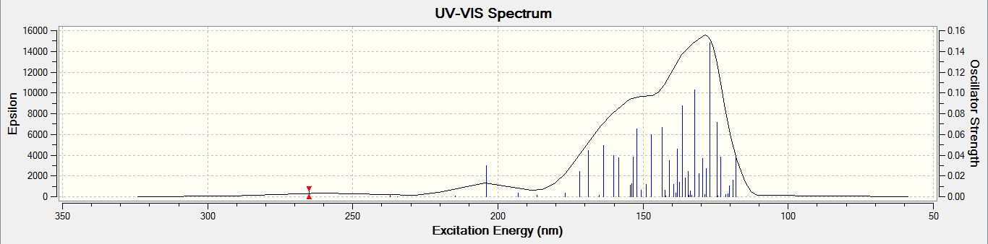
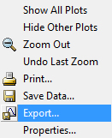
Analyzing result:
Energy simulation
Molecule
Completed Energy calculation
Double click the output
Open in Gaussview
Absorption curve
Oscillator strength

Slide 48
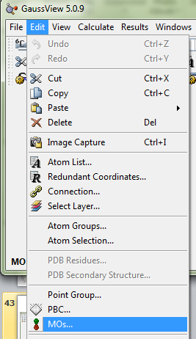
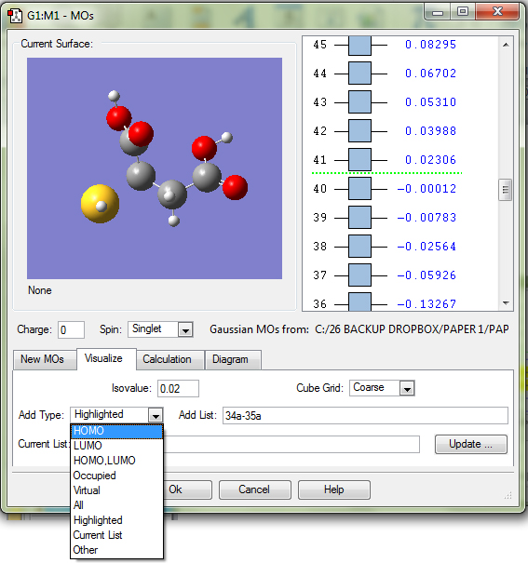
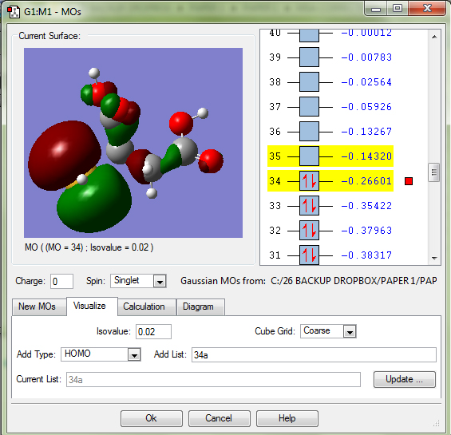
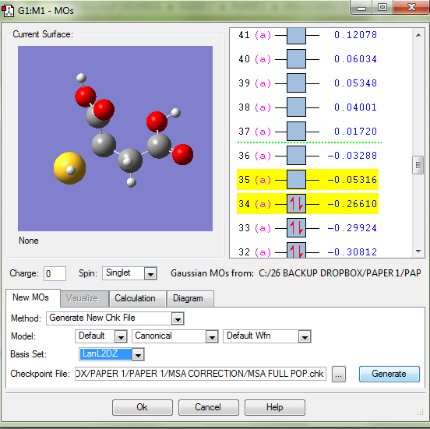
Analyzing result:
Full Population
Molecule
Completed Full Population
Double click the output
LUMO
Open in Gaussview
HOMO
Excited state energy, LUMO=-0.14320 H x 26.211=-3.753 eV
Ground state energy, HOMO: -0.26601 H x 26.211=-6.972 eV

Slide 49

Analyzing result:
Molecule size
Molecule
Completed Size calculation
Double click the output
Open in Gaussview
Surface area (sphere)= 4πr²
197.708 Å² = 12.568 r²
r = 3.966 Å
d = 7.932 Å

Slide 50
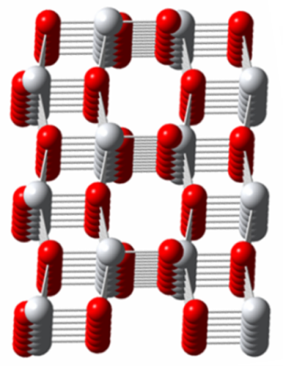
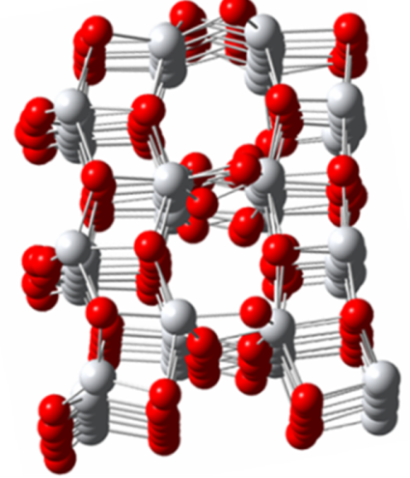
Input: QD semiconductor
Crystal
BULK semiconductor:
  Crystal
  Bond length, angle and dihedral angle
  are constant
QUANTUM DOT semiconductor:
  Quasi-crystal
  Bond length, angle & dihedral angle
  change due to surface relaxations
  FULL OPTIMIZATION
  (bond length, angle & dihedral)
Puzder et al Phys. Rev. Lett. 92, 217401 (2004) Self-Healing of CdSe Nanocrystals: First-Principles Calculations

Slide 51
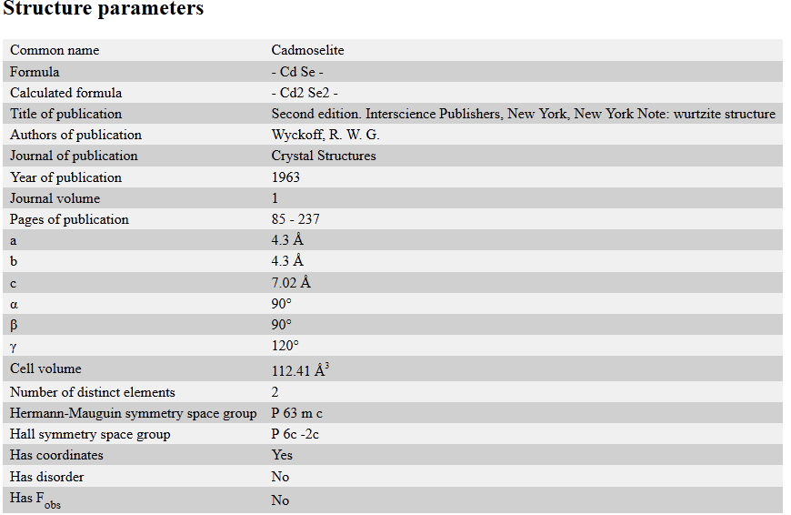
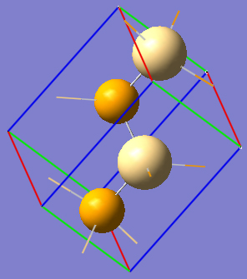
Input Step 1: Download CIF
Crystal
Download (example: CdSe) CIF file from: www.crystallography.net
Based on the CIF, build our own cluster

Slide 52
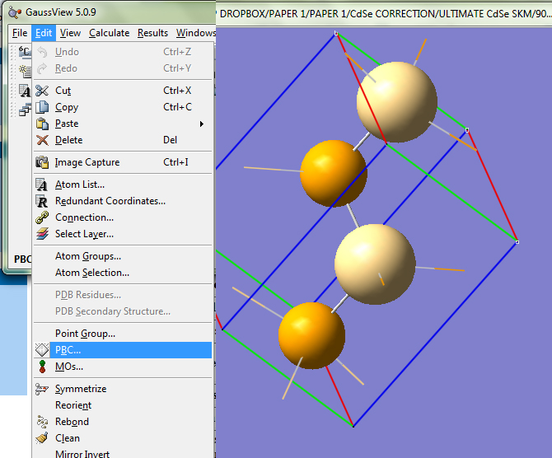
  Input Step 2: Open PBC
Crystal

Slide 53
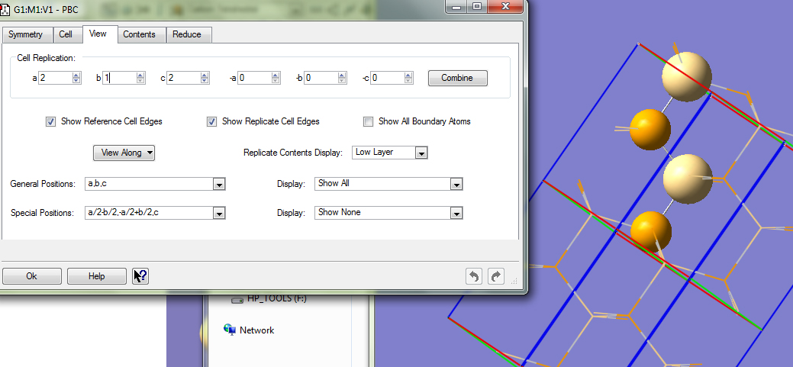
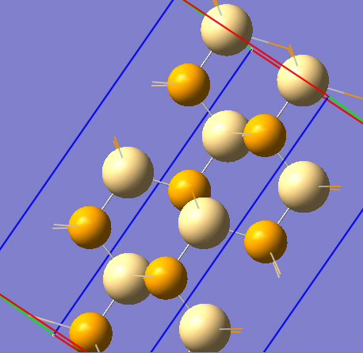
  Input Step 3: Make bigger cluster
Crystal

Slide 54

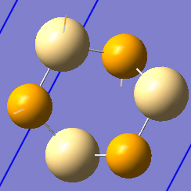
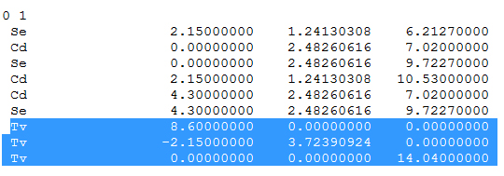
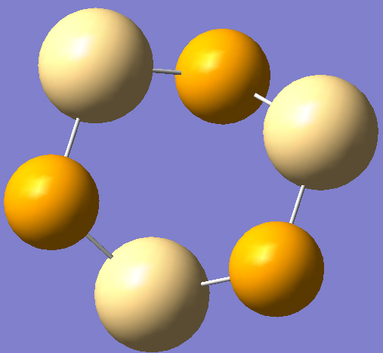
  Input Step 4:
  Making smallest meaningful cluster
Crystal
Save
Click “Results”
Click “View Files”
Delete “TV”
Save
Close & open again
(CdSe)₃
Jose et. al J. Am. Chem. Soc. 2006, 128, 629-636

Slide 55
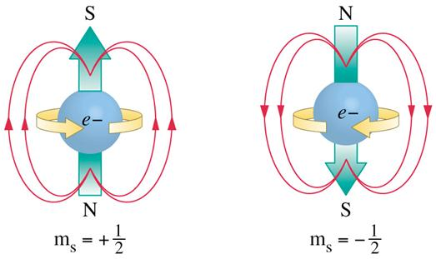
Spin multiplicity
Crystal
Singlet State: 2S+1=1
  2(nx1/2)+1=1
  n=0 (no unpaired electrons/all electrons are paired)
  No resultant magnetic moment
  Magnetic moment produced by electron spin +1/2 and -1/2 cancel out each other
  The materials becomes diamagnetic
  Produce slight magnetic field opposing external magnetic field
  Bulk CdSe is a diamagnetic material
  Neeleshwar et. al. Physical Review B, 2005

Slide 56
Spin multiplicity
Crystal
State | 2S+1 | S=nx1/2 | n
Doublet | 2 | ½ | 1
Triplet | 3 | 1 | 2
Quadruplet | 4 | 3 ½ | 3
Pentuplet… | 5… | 2… | 4…
Material properties: Paramagnetic, Ferromagnetic, Antiferromagnetic, Ferrimagnetic
BACK TO LITERATURE REVIEW

Slide 57
  Input Step 5:
  Z-Matrix Preparation & Start
Crystal
SIZE 1 cluster
SIZE 2 cluster
SIZE n cluster
Rearrange labels
HOW can we say our cluster is a REALISTIC cluster model?
Z-matrix constructions
Z-matrix testing
NOT OK
COMPARE with experimental work
OK
GEOMETRY optimization
FREQUENCY
simulation
FREQUENCY
simulation
ENERGY
calculations
ENERGY
calculations
FULL POP
SIZE
calculation
SIZE
calculation
POSITIVE
Absorption
Calculated size

Slide 58
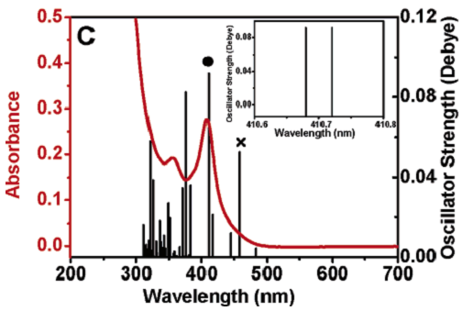
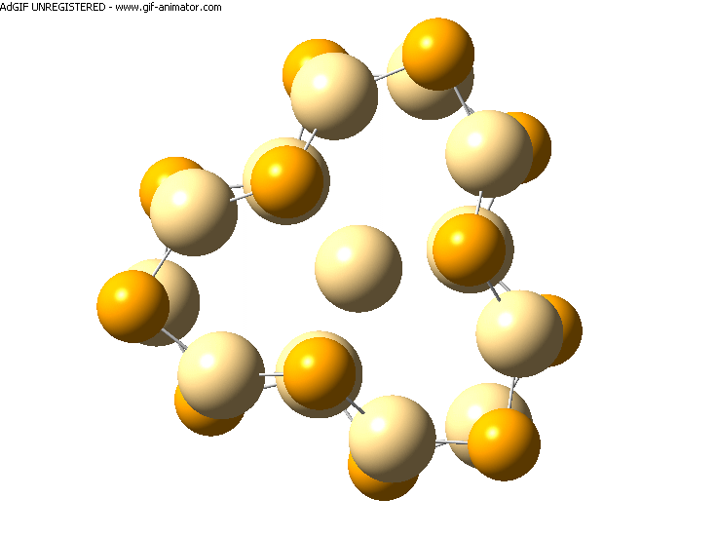
Analysis: A realistic cluster model
Crystal
Experiment
Simulation
Size Matching
1st excitonic peak-oscillator strength
comparison
Absorption is structure correlated
Realistic Cluster Model?
YES
NO
Meaningful simulated results
R. Jose et.al. J. Am. Chem. Soc. 2006

Slide 59
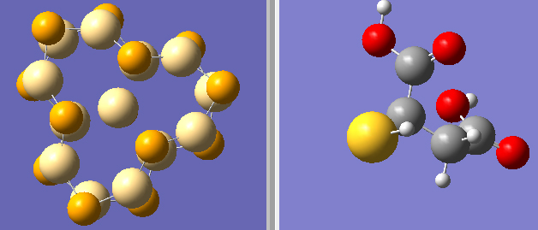
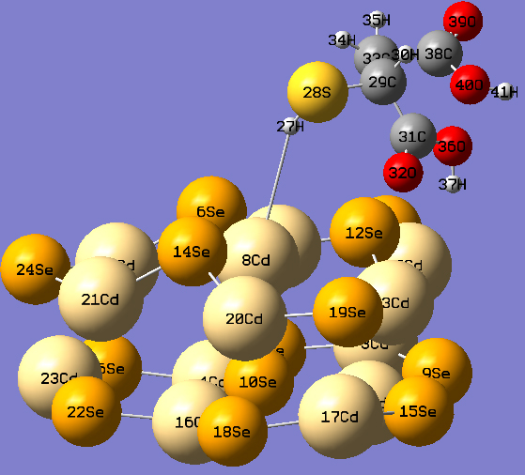
QD+Ligand model:
Reference model preparation
Molecule
Crystal
Open Ligand & QD model in Gaussview
Copy Ligand model
Left click on the QD model to add ligand model
Adjustment of position needed
Link “H” in –SH functional group to Cd atom of QD using: (from literature)
Save reference model
OPTIMIZATION PARAMETER:
The bond between QD and Ligand
The angle & dihedral angle in ligand

Slide 60


QD+Ligand model: z-matrix preparations
Molecule
Crystal
QD’s Z-matrix: With pre-optimized bond length, angle & dihedral angle
Ligand’s Z-matrix: With fixed bond length. Angle & dihedral angle are to be optimized
Change ligand’s Z-matrix numbering by adding 26 to the current reference number
Ligand’s atom number 1 will be = 1+26=27
2 will be 2+26=28…so on & so forth
This Se is the 26th defined atom

Slide 61

QD+Ligand model:
The new Z-matrix
Molecule
Crystal
QD
REDEFINE THE FIRST THREE ATOM OF LIGAND’S MOLECULE
X1=3.
Y1=86.
Y2=147.
Y3=109.
Z1=-113.
Z2=-173.
Z3=92.
H, 8, X1, 14, Y1, 20, Z1
S, 27, 1.31, 8, Y2, 6, Z2
C, 28, 1.78, 27, Y3, 8, Z3
Ligand
FINALIZED Z-MATRIX

Slide 62



Result analyses:
Magic size cluster
SC
Determination of electronically stable QD structure for synthesis. (1.5nm in CdSe):
  Largest quantities with identical properties
  Efficient electron injections
(CdSe)₆
(CdSe)₁₃
(CdSe)₁₆
WHICH ONE OF THESE CLUSTERS, ELECTRONICALLY STABLE?
R. Jose et al & Saifful et al

Slide 63
Result analyses:
LUMO_{QD}-LUMO_{ligand} comparison
SC
e⁻
Ligand
QD
ELECTRON INJECTIONS: INEFFICIENT
LUMO=-3.897 eV
LUMO=-4.188 eV
HOMO=-6.529 eV
HOMO = -7.238 eV

Slide 64

Result analyses:
Electron injection efficiency
SC
Electron population at
ligand
ELECTRON INJECTIONS: INEFFICIENT
Electron populations at QD

Slide 65
Result analyses:
QD-Ligand adsorption & strength
SC
Ligand
QD
<0.4 eV
>0.4 eV
Energy: X
Physisorption
Chemisorption
Energy: Y
B3LYP/LANLDZ
B3LYP/LANLDZ
E_{ad}=+
EXOTHERMIC
Ligand
QD
ΔH=E_{released} – E_{used}=NEGATIVE
Energy released
(bond making)
>
Energy used (bond breaking)
Energy: Z
B3LYP/LANLDZ
Adsorption Energy E_{ad}=Z-(X+Y)
ENDOTHERMIC
E_{ad}=-
ΔH=E_{released} – E_{used}=POSITIVE
Energy released
(bond making)
<
Energy used (bond breaking)

Slide 66
Result analyses:
Adsorption: Basis Set Superposition Errors
SC
Ligand
QD
Energy: X
B3LYP/LANLDZ
B3LYP/LANLDZ
Ligand
QD
Energy: Z
B3LYP/LANLDZ
Adsorption Energy E_{ad}=(Z+ΔBSSE)-(X+Y)
Will not be covered, for the time being
Zhanpeisov et. al. J. Am. Chem. Soc. 2004

Slide 67




DFT Kick Start
(David S. Sholl et. al.2009)

