Slide 1
Three mistakes we have made during fabrication of quantum dots solar cell; How can you learn from them
Saifful Kamaluddin bin Muzakir
saifful@ump.edu.my / 019 276 3844

Slide 2
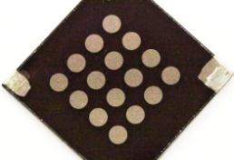
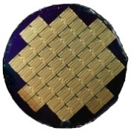
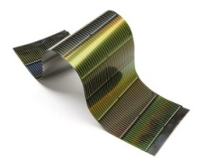
State of the Art
Source: National Renewable Energy Laboratory
3rd Generation
Molecular Absorber Solar Cells
Research
1st Generation
Crystalline Solar Cells
Commercial
2nd Generation
Thin Film Solar Cells
Commercial
>60%
Theoretical PV conversion efficiency of 1 cell
Experimental PV conversion efficiency of 1 cell
32%
32%
32%
32%
29%
28%
21%
13%
11%
GaAs
c-Si
CIGS/a-Si
Dye
Quantum Dots

Slide 3
Device Structure
E
A. DSSC
Dye
R
TiO₂
O
Conducting glass
Working electrode
Liquid electrolyte
Counter electrode
H
B. QDSC with ligand
Conducting glass
P
TiO₂
QD
O
R
Ligand
O
C. QDSC without ligand
U
L
TiO₂
QD
F
Muzakir et al. 2013. Physical Chemistry Chemical Physics. 15:16275-16285.

Slide 4
Working Principle
E
LUMO
A. DSSC
e
e
e
V_{OC}
R
excitation
Dye
e
e
TiO₂
O
h
H
HOMO
P
e
B. QDSC with ligand
e
e
e
O
QD
ligand
e
e
TiO₂
h
R
O
C. QDSC without ligand
e
U
e
e
L
TiO₂
QD
h
e
e
F
e
e
External Circuit
Muzakir et al. 2013. Physical Chemistry Chemical Physics. 15:16275-16285.

Slide 5
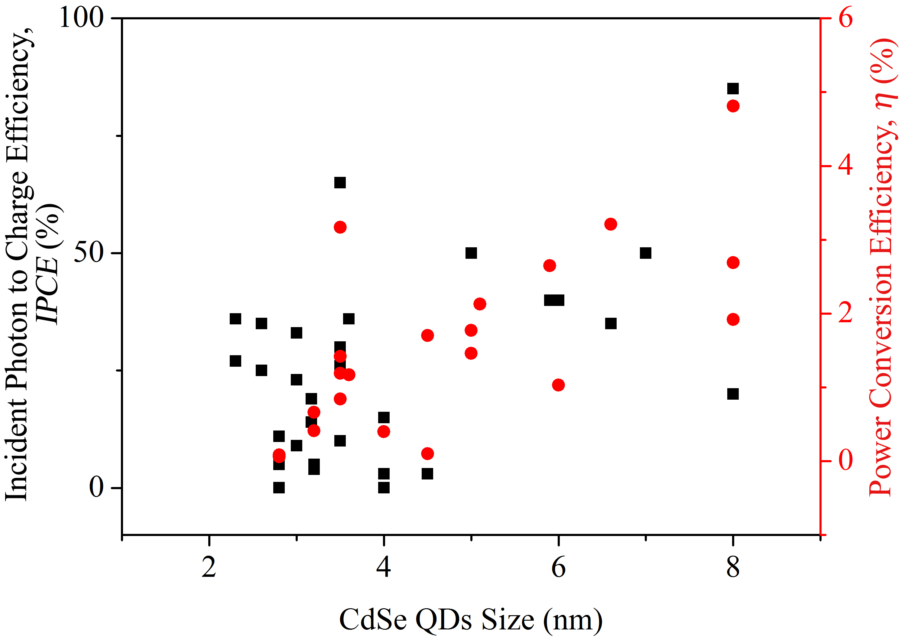
Size of QDs vs. performance of QDSC
The yielded IPCE (boxes) and PCE (circles) by fabricated cell using respective CdSe QDs size

Slide 6
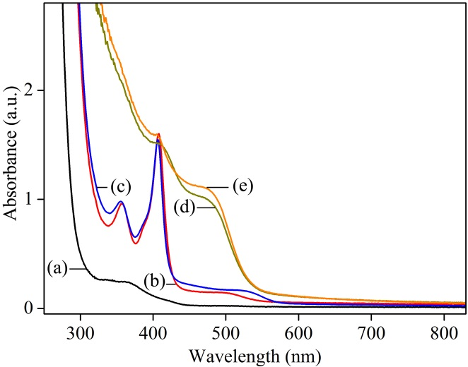
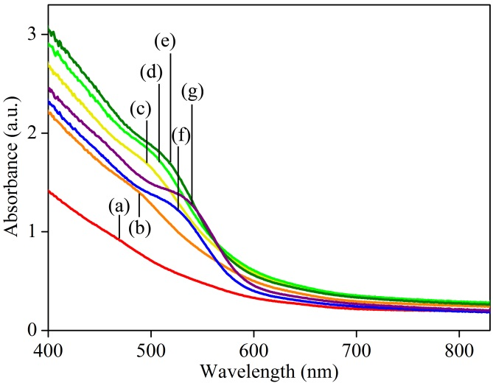
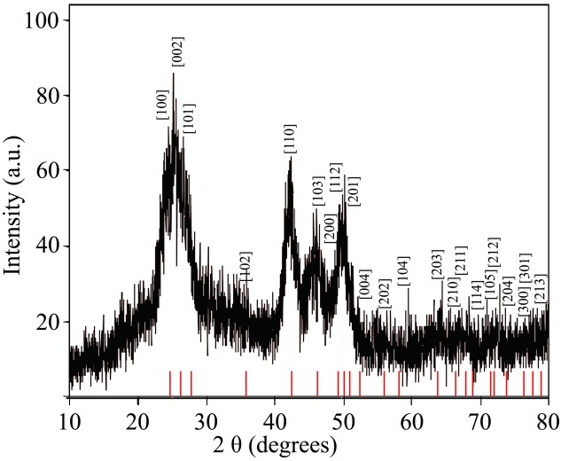
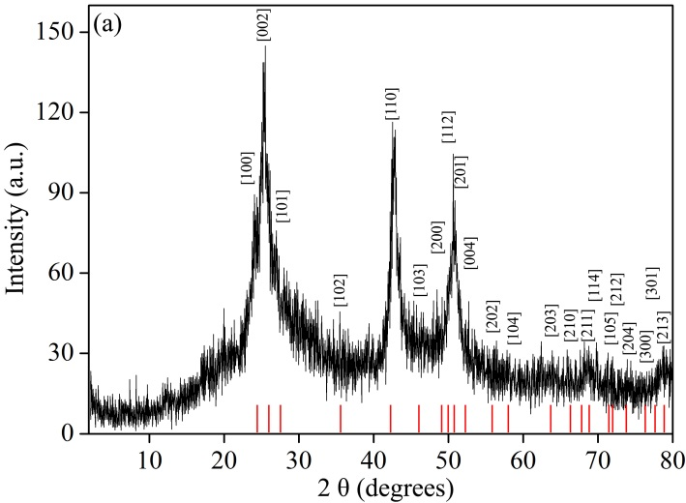
CdSe QDs synthesis: Organometallic vs Microemulsion
4 h at 23 °C
64 h at 23 °C
169 h at 23 °C
5 h at 50 °C
After 24 h cooling
1 min at 37 °C
5 min at 37 °C
10 min at 37 °C
15 min at 37 °C
30 min at 37 °C
60 min at 37 °C
120 min at 37 °C
Narrow size distributions
of small QDs
Wide size distributions of big QDs
Wurtzite P63mc crystal structure
Wurtzite P63mc crystal structure

Slide 7
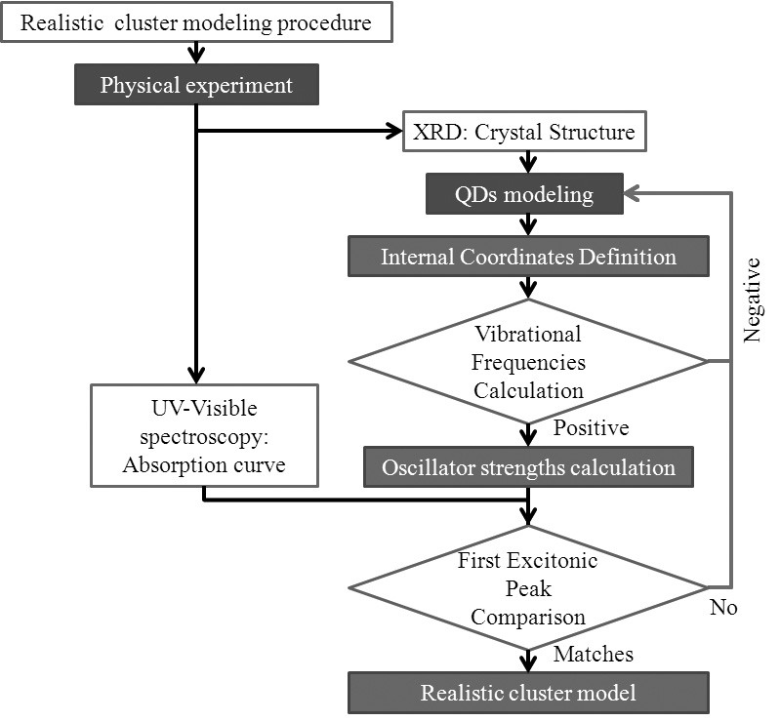
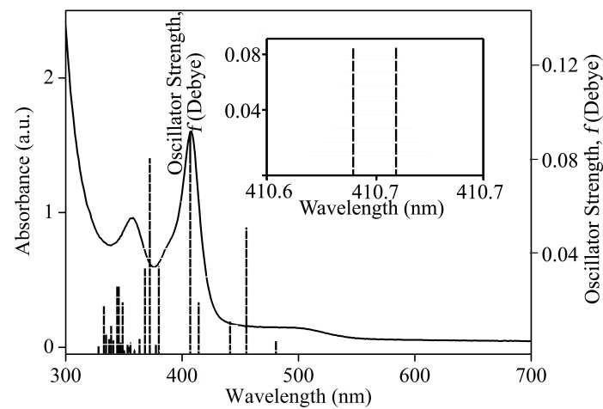
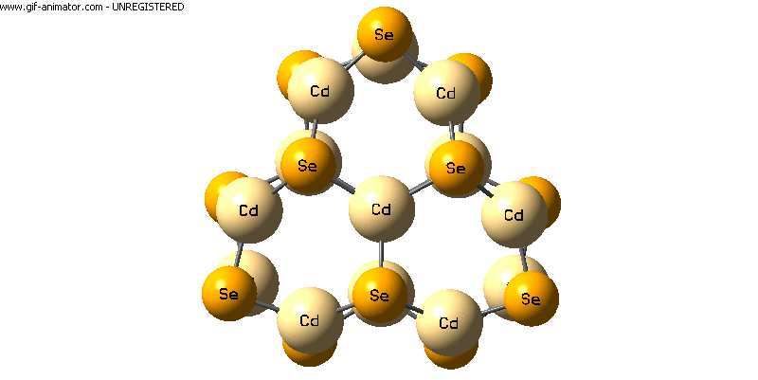
DFT: Realistic cluster modeling
(CdSe)₁₃

Slide 8
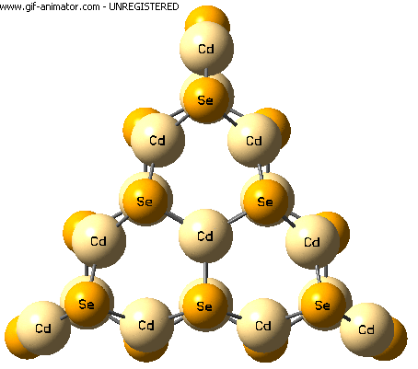
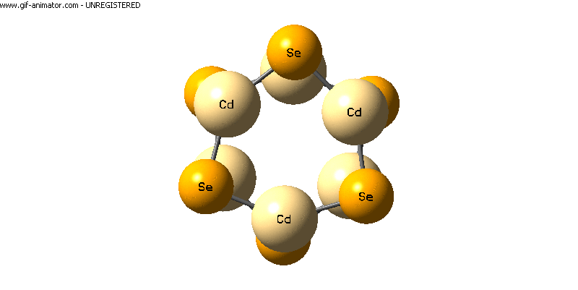
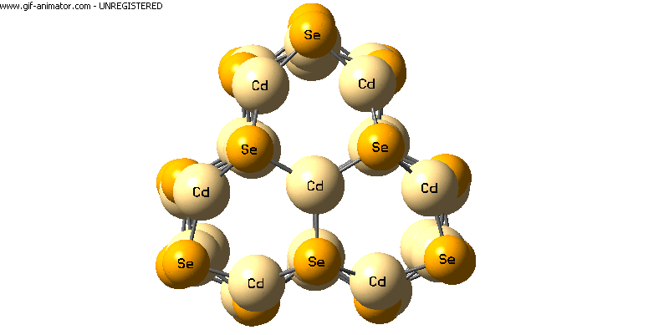
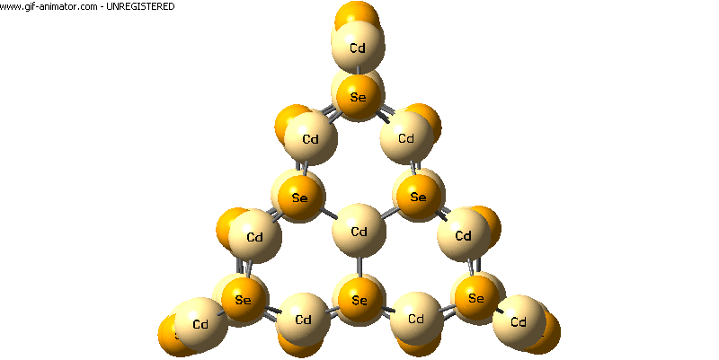
Realistic Cluster Models
Muzakir et al. 2013. Physical Chemistry Chemical Physics. 15:16275-16285.
(CdSe)₆
(CdSe)₁₃
(CdSe)₁₆
(CdSe)₂₆
(CdSe)₃₂

Slide 9
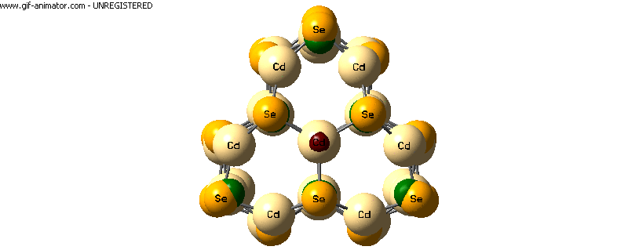
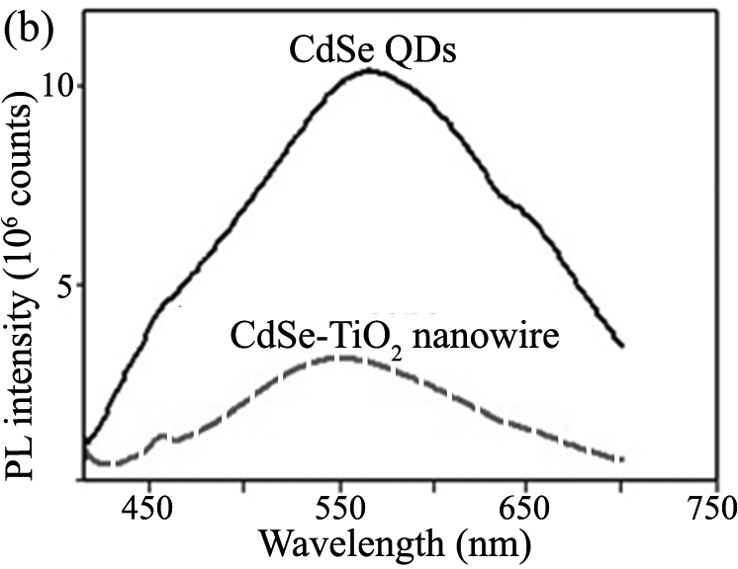
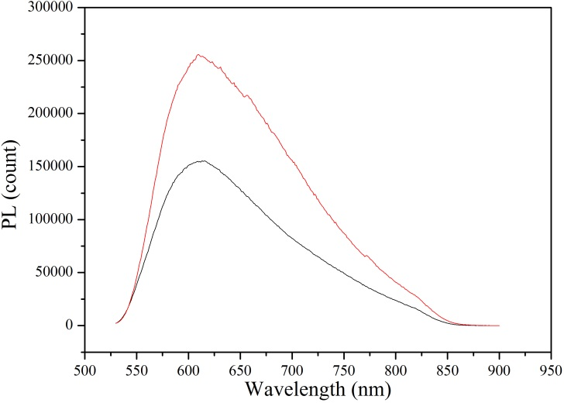
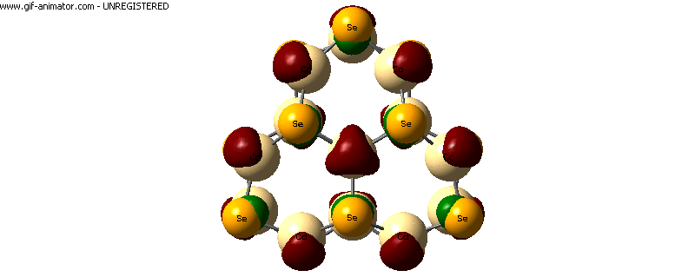
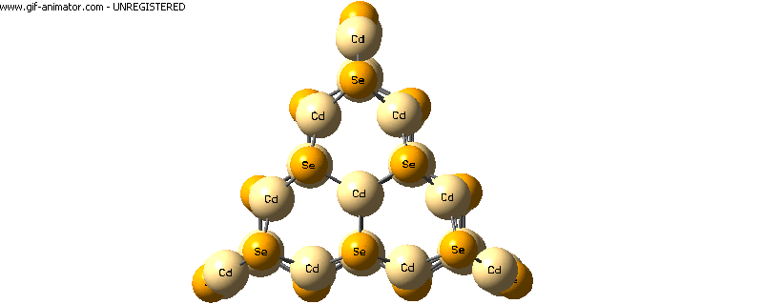
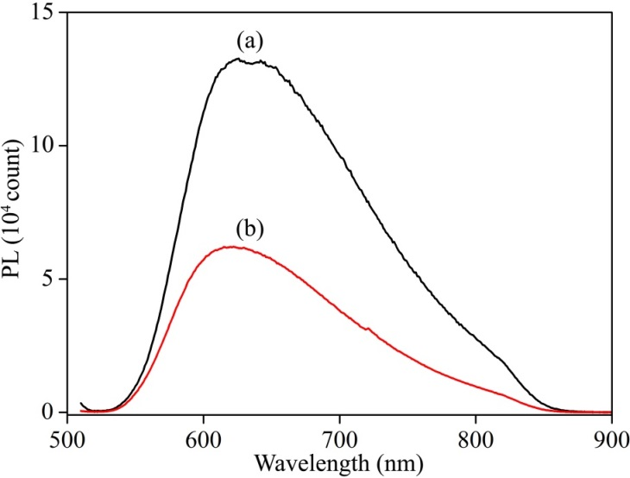
Mistake #1: The best size
SILAR
Direct Attachment
1.90 nm
(CdSe)₁₃
(CdSe)₁₃
~(CdSe)₃₂
~73%
~39%
~73%
CdSe - TiO₂
(CdSe)₃₂ - TiO₂
(CdSe)₁₃ - TiO₂
1.90 nm
3.02 nm
7.76 nm
CBD
~(CdSe)₂₆
~53%
(CdSe)₂₆ - TiO₂

Slide 10
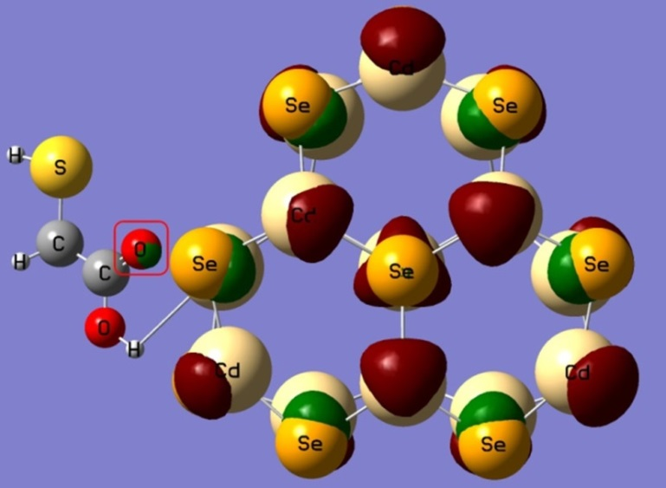
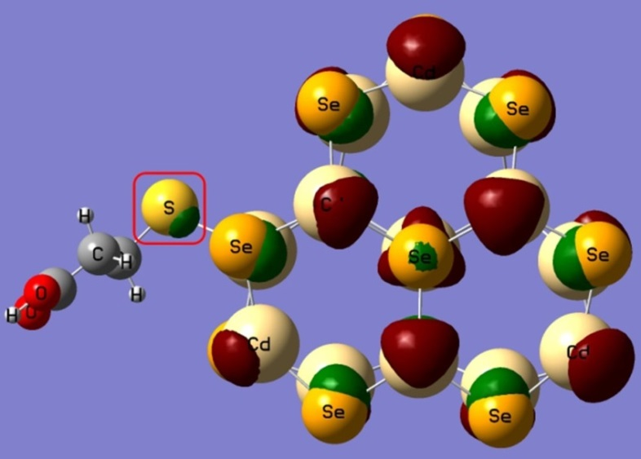
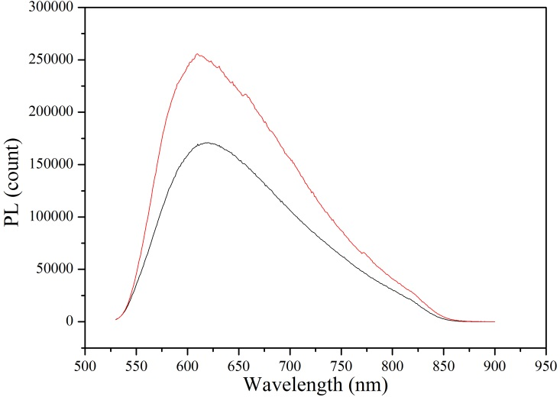
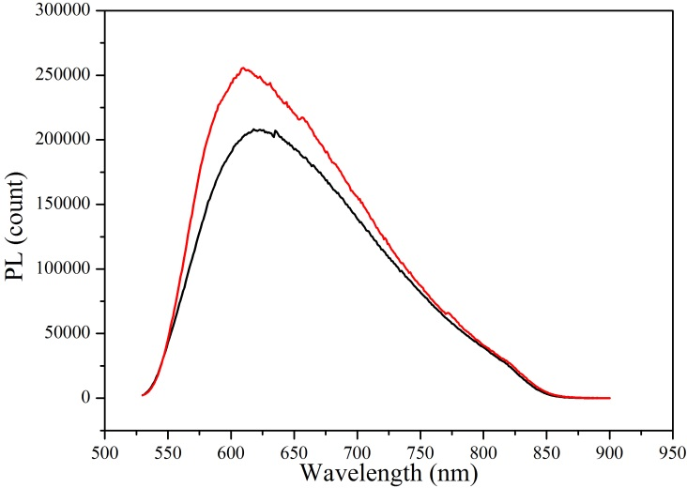
Mistake #2: Ligand usage
-3.63 eV
-4.188 eV
MPA
(CdSe)₁₃
-7.14 eV
-6.529 eV
-3.61 eV
Ligand Assisted
Ligand Assisted
-4.188 eV
~(CdSe)₃₂
~(CdSe)₃₂
MAA
~33%
(CdSe)₁₃
~19%
-7.11 eV
-6.529 eV
(CdSe)_{z}-MSA-TiO₂
(CdSe)_{z}-MPA-TiO₂

Slide 11
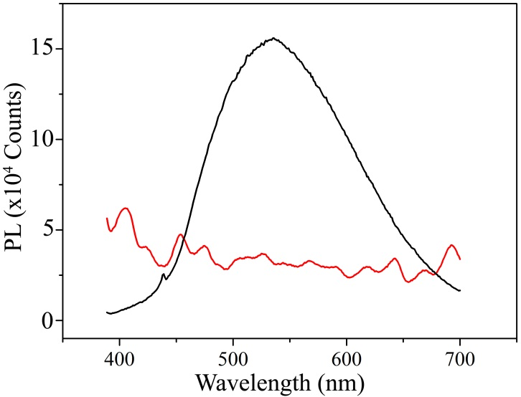
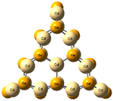
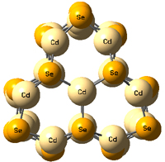
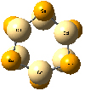
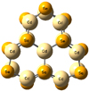
Mistake #3: Size distribution
Narrow size distribution
~100%
CdSe - TNRs
1.50 nm
1.90 nm
2.02 nm
2.44 nm
-4.020 eV
-4.188 eV
~19%
-4.208 eV
-4.200 eV
(CdSe)₆
(CdSe)₁₃
-4.993 eV
(CdSe)₁₆
TiO₂
500 nm
530 nm
556 nm
(CdSe)₂₆
634 nm
Wide size distribution
-6.495 eV
-6.529 eV
-6.438 eV
-6.950 eV
-7.200 eV

Slide 12
Conclusion
Efficient injection
The best size
Suitable ligand
Narrow size distribution

Slide 13
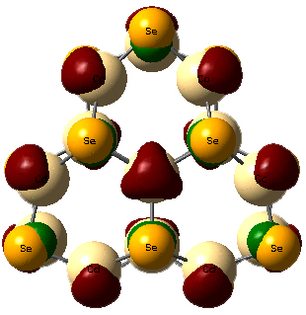
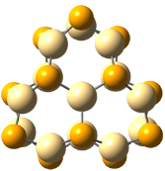
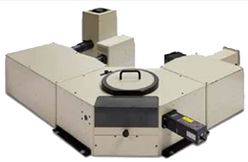
Electron injection efficiency
Nonradiative
e
e
e
LUMO
LUMO
CdSe
Detector
C.B.
CdSe
PL intensity
100 %
PL intensity
TiO₂
Screen
HOMO
h
Wavelength (nm)
e
HOMO
e
Wavelength (nm)
h
V.B.
PL intensity
Wavelength (nm)
Notes:
To harvest these excited state electrons, QDs are adsorbed onto the MOS surface.
In the QDs-MOS conjugate, upon absorption of photon with sufficient energy, the excited state electron has two options; (i) first is to recombine with hole in HOMO and (ii) second is to be injected into the lower lying LUMO energy level of MOS.
If all electron recombine into the HOMO, the PL intensity will be the same as the PL of bare QDs.
If all electron injected into the LUMO of MOS, the PL intensity is totally quenched.
Therefore, efficient electron injection is indicated by high percentage of PL intensity quenching in QD-MOS conjugates; in comparison with the PL intensity of the bare QDs.
The electron injection efficiency from QDs to MOS was quantitatively measured using photoluminescence spectroscopy.
In bare QDs, upon absorption of photon with sufficient energy, electron in the HOMO is excited to LUMO energy level leaving hole at the HOMO.
The electron then recombine with the hole in the HOMO thus produces photon.
This photon is detected by photoluminescence spectrometer and PL intensity vs wavelength plot is produced. The intensity of PL depends on the number of recombination. The more excited state electron recombines to the HOMO, the higher the PL intensity would be.

